Slide 1
A Tour of Computer Systems
Lesson 1

Slide 2
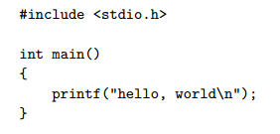
Hello Program’s Life Time
Find out how the CODE is executed by tracing the lifetime of the hello program

Slide 3
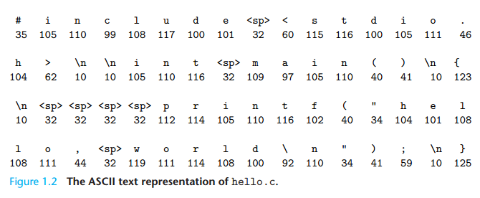
The Contents of the “hello world”

Slide 4
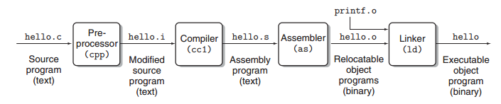
Compilation system
Preprocessing phase
Compilation phase
Assembly phase.
Linking phase
预处理
编译
汇编
链接

Slide 5
Assembly Program
1 main:
2 subq $8, %rsp
3 movl $.LC0, %edi
4 call puts
5 movl $0, %eax
6 addq $8, %rsp
7 ret

Slide 6
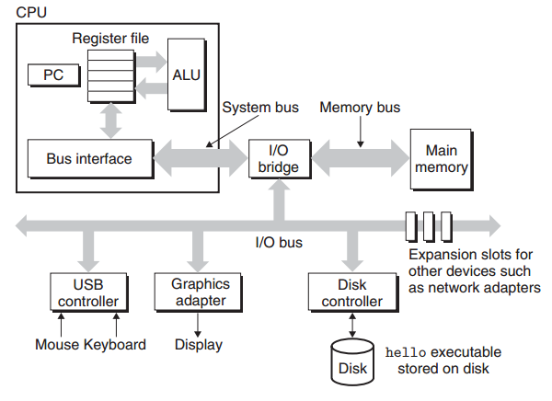
Hardware organization of a typical system
BUS （总线）
I/O（输入输出）
Main Memory（主存）
Disk（硬盘）
CPU（中央处理器）
PC : Program Counter.
ALU: arithmetic/logic unit
Rregister File: a small storage device that consists of a collection of word-sized registers, each with its own unique name.

Slide 7
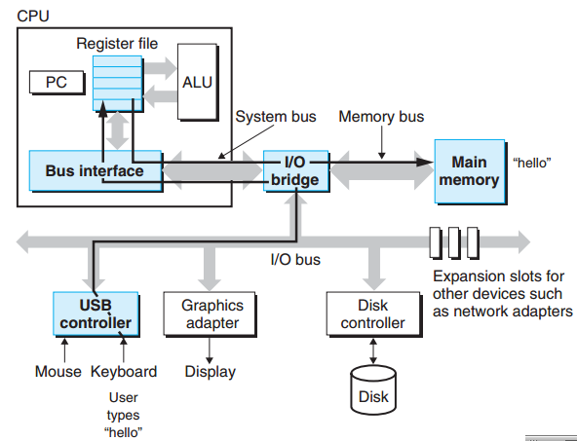
Running the hello Program
Reading the hello command from the keyboard.

Slide 8
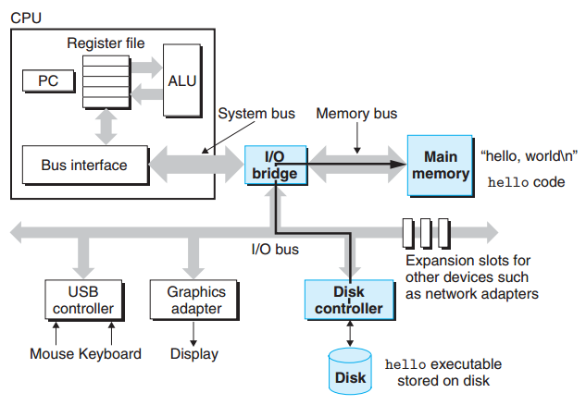
Running the hello Program
Loading the executable from disk into main memory

Slide 9
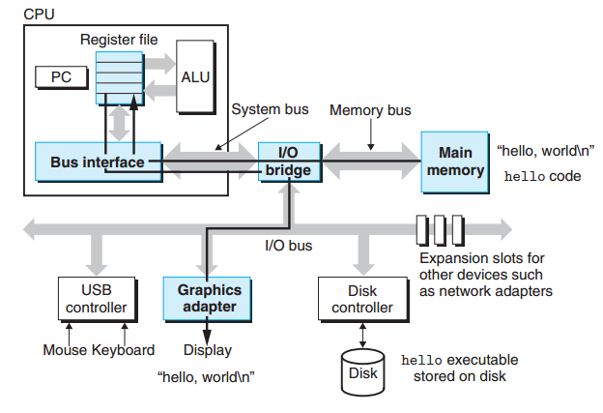
Running the hello Program
Writing the output string from memory to the display.

Slide 10
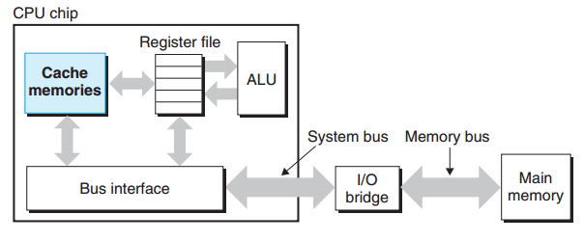
Caches Matter

Slide 11
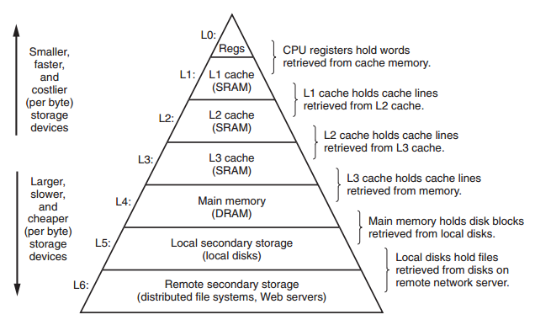
An example of a memory hierarchy

Slide 12
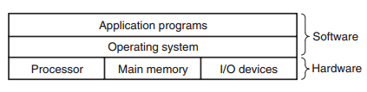
Operating System
Manages the Hardware

Slide 13
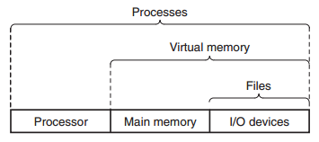
Operating System
Abstractions（抽象） provided by an operating system
fundamental abstractions : processes, virtual memory, and files.
files ：abstractions for I/O devices,
virtual memory： an abstraction for both the main memory and disk I/O devices
processes：abstractions for the processor, main memory, and I/O devices. We will discuss each in turn.

Slide 14
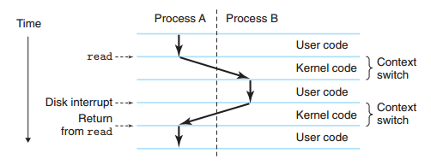
Processes（进程）
A process is the operating system’s abstraction for a running program. such as hello runs on a modern system

Slide 15
Threads（线程）
Threads：in modern systems a process can actually consist of multiple execution units, called threads,

Slide 16
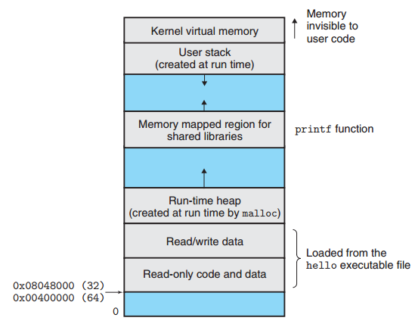
Virtual Memory
Virtual memory is an abstraction that provides each process with the illusion that it has exclusive use of the main memory
地址高端
地
址低端
Stack
Shared libraries
Process virtual address space.
Heap
Program code and data

Slide 17
Files
A file is a sequence of bytes, nothing more and nothing less.
Every I/O device, including disks, keyboards, displays, and even networks, is modeled as a file.
All input and output in the system is performed by reading and writing files, using a small set of system calls known as Unix I/O

Slide 18
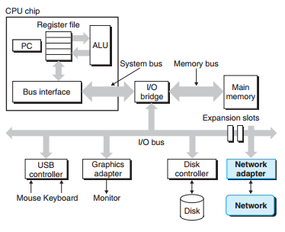
Communicate with Other Systems Using Networks
A network is another I/O device.
Local machine’s main memory⬅➔ Network machine
Internet: email, instant message, WWW, FTP telnet, Cloud, etc.

Slide 19
Amdahl’s Law
Amdahl定律揭示了提升系统某一部分性能对系统整体性能的影响。
该定律的主要思想：对系统的某个部分加速时，其对整体性能的影响取决于该部分的重要性和加速程度。
T_{new} = (1 - α)T_{old} + (α T_{old}) / k = T_{old}[(1 - α) + α/k]
α: 系统中某部分执行时间占总执行时间的比例
k: 系统中该部分性能提升比例

